Slide 1
Object Oriented Programming CS F213 Amit Dua
Slide material from book “Head First Design Patterns”

Slide 2
Design patterns

Slide 3
Topics to be covered
Design patterns motivation
Strategy Design pattern
Practical example buildup and solution

Slide 4
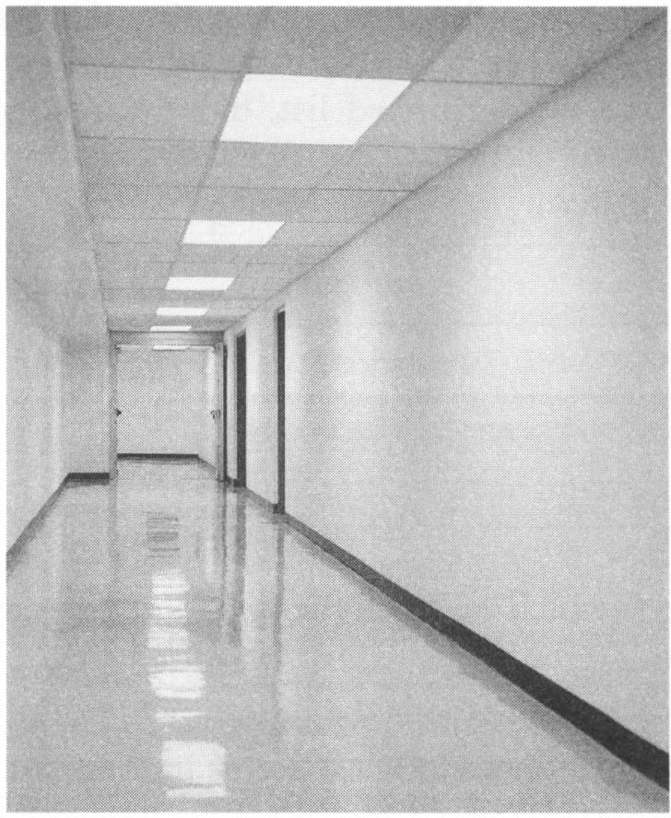
Design pattern
Christopher Alexander (Arch)
250 patterns for architectural
design.
A short name
• A brief description of the context
• A lengthy description of the problem
• A prescription for a solution

Slide 5
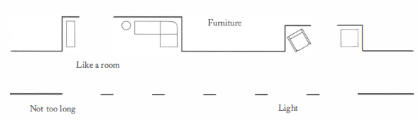
Example of Pattern
Name: Short passage
Context: long, sterile corridors set the scene for everything bad about modern architecture
Problem:
Solution:

Slide 6
Patterns
A pattern presents proven advice in a standard format
Alexander designed for architecture
We need for software development

Slide 7

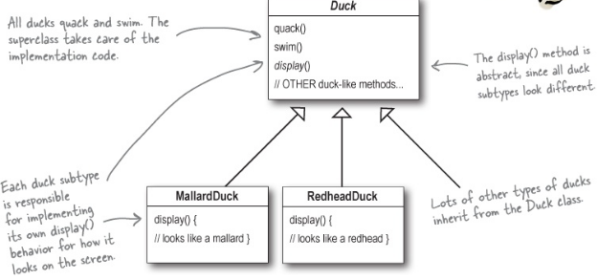
Joe the programmer

Slide 8
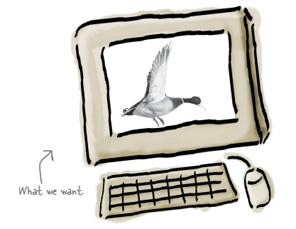

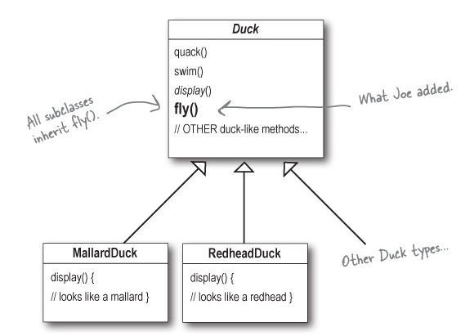
New Problem
something is horribly wrong...

Slide 9
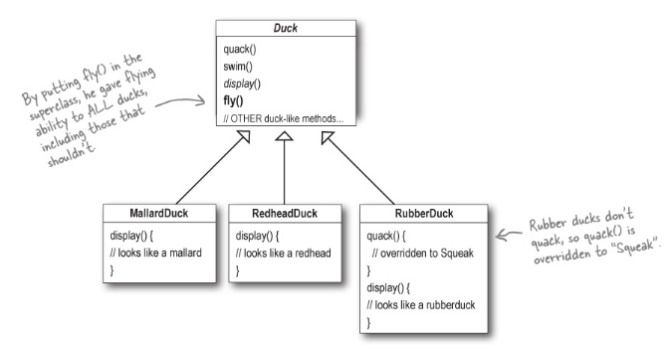
Recommend a solution to Joe

Slide 10
Problems with the patch up solution
Code is duplicated across subclasses.
Runtime behavior changes are difficult.
Hard to gain knowledge of all duck behaviors.
Changes can unintentionally affect other ducks.

Slide 11
Bigger problem
override fly() and quack() for every new Duck subclass
Solutions?

Slide 12
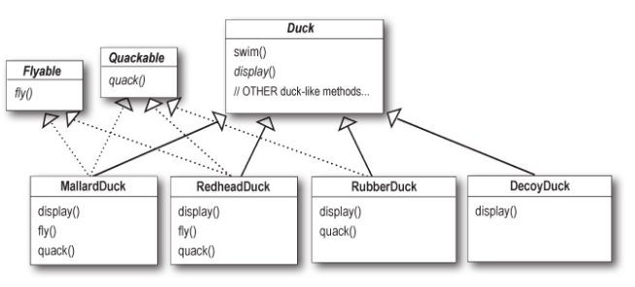
Another solution
What do YOU think about this design?
Duplicate code

Slide 13
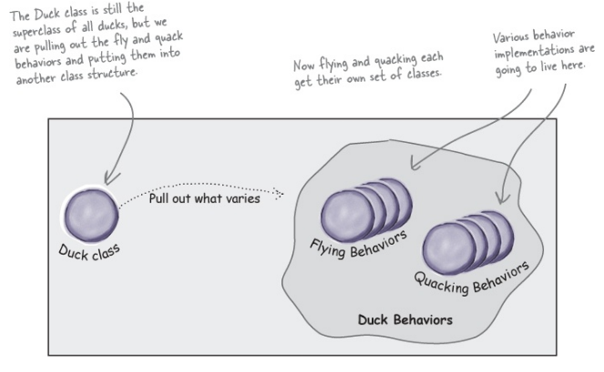
Solution <Encapsulate what varies>

Slide 14
Program to an interface, not an implementation.
You can program to an interface, without having to actually use a Java interface.
The point is to exploit polymorphism by programming to a supertype.
So that the actual runtime object isn’t locked into the code.

Slide 15

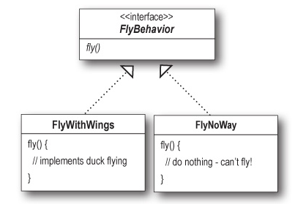
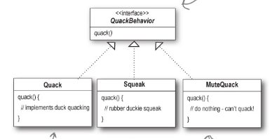
Concept building

Slide 16
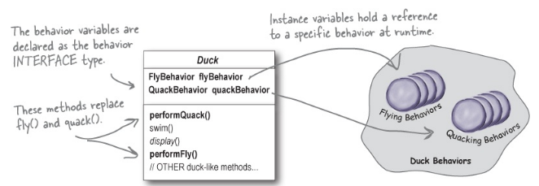
Integrating the Duck Behavior

Slide 17
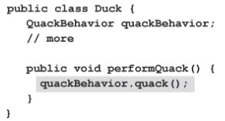
implement performQuack()

Slide 18
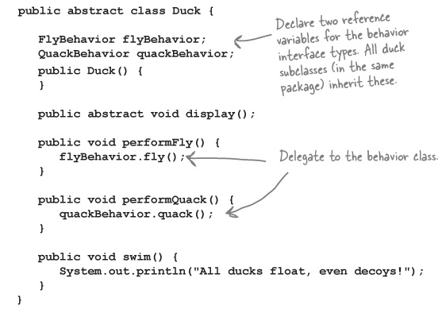
Duck abstract class

Slide 19
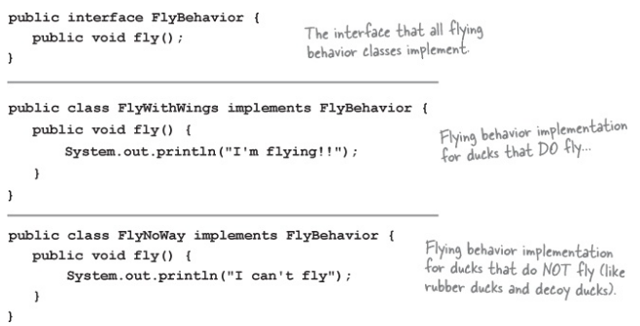
FlyBehavior interface and implementations

Slide 20
QuackBehavior interface and implementations
public interface QuackBehavior { public void quack(); } _____________________________________________ public class Quack implements QuackBehavior { public void quack() { System.out.println("Quack"); } } _____________________________________________ public class MuteQuack implements QuackBehavior { public void quack() { System.out.println("<< Silence >>"); } } _____________________________________________ public class Squeak implements QuackBehavior { public void quack() { System.out.println("Squeak");}}

Slide 21
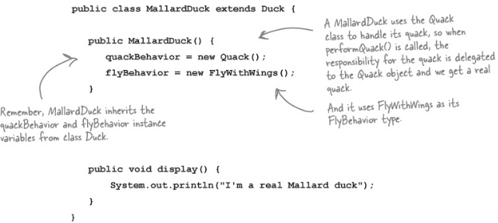
MalladDuck class

Slide 22
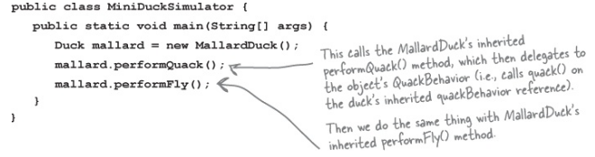
DuckSimulator

Slide 23
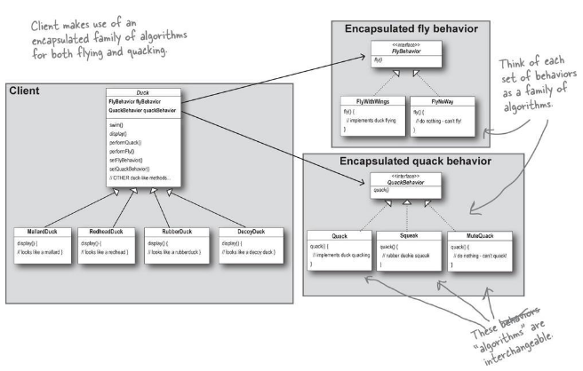
Favor composition over inheritance.

Slide 24
Strategy Pattern
The Strategy Pattern defines a family of algorithms, encapsulates each one, and makes them interchangeable. Strategy lets the algorithm vary independently from clients that use it.

Slide 25
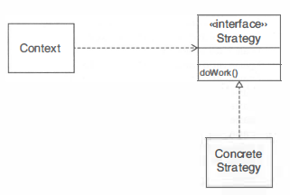
Strategy Pattern

Slide 26
Strategy Pattern
Context
1 . A class (which we'll call the context class) can benefit from different variants of an algorithm.
2. Clients of the context class sometimes want to supply custom versions of the algorithm .
Solution
1. Define an interface type that is an abstraction for the algorithm. We'll call this interface type the strategy.
2. Concrete strategy classes implement the strategy interface type. Each strategy class implements a version of the algorithm.
3. The client supplies a concrete strategy object to the context class.
4. Whenever the algorithm needs to be executed, the context class calls the appropriate methods of the strategy object.

Slide 27
Questions

